Slide 1


SEO Audit Report
Cognizant.com
66
This report provides a comprehensive review of key factors that influence the SEO and usability performance of your website, Cognizant.com. The homepage rank is based on a 100-point scale, where a score below 40 indicates significant room for improvement and a score above 70 suggests your website is well optimized. Internal pages are graded from A+ through E, based on nearly 30 additional factors.
This report includes actionable recommendations to help enhance your site’s performance and business objectives.
by Abubakkar Siddiq

Slide 2

Cognizant:
Cognizant is a leading global technology and consulting company that provides IT services, including digital, technology, consulting, and operations solutions. Headquartered in Teaneck, New Jersey, Cognizant helps businesses across industries modernize technology, reimagine processes, and transform customer experiences.
The company’s official website is www.cognizant.com.

Slide 3

Search Engine Optimization:
Title Tag
Meta Description
Content: Intuition engineered—human insight, superhuman speed | Cognizant
Content: Anticipate trends. Drive meaningful change. Outthink your competition. That’s the power of intuition—and we can engineer it. Learn more.
Length: 64 characters ✅
Length: 136 characters ✅

Slide 4
Meta Keywords & Headings Analysis
Meta Keywords
Headings
❌ No keywords found. Consider adding relevant keywords for better indexing.
H1: 4 H2: 0 H3: 1 H4: 0 H5: 11 H6: 0
Keyword Cloud & Consistency
Keyword Cloud (Top Occurrences)
background (8), style (6), business (5), vertical (4), workforce (3), more, bottom, future, multi-agent, help, content (2–3 each)
Keyword Consistency
⚠️ Consider reviewing keyword distribution for alignment with target SEO strategy.

Slide 5
Image Alt Attributes
Alt Attributes
Recommendation
- 11 images found
Ensure all images have descriptive ALT attributes for improved accessibility and SEO.
❌ 2 images missing ALT attributes. Add descriptive alt text for accessibility and SEO.
Text/HTML Ratio & GZIP Compression
Text/HTML Ratio
GZIP Compression
Text Content: 5,137 bytes
✅ Enabled – Page compressed from 25 KB to 4 KB (82.1% size savings)
HTML Size: 25,661 bytes
Ratio: 20.02% ✅
(Fair, but could be improved for better SEO impact)

Slide 6
IP Canonicalization & URL Rewrite
IP Canonicalization
URL Rewrite
❌ The domain IP (151.101.195.10) does not redirect to cognizant.com. Recommend setting a canonical redirect to ensure consistency.
✅ All URLs are clean and user-friendly.
Underscores in URLs & WWW Resolve
Underscores in URLs
WWW Resolve
❌ Underscores detected in some URLs. Best practice is to use hyphens (e.g., this-is-better).
✅ Proper redirection from non-preferred domain.

Slide 7
XML Sitemap & Robots.txt
XML Sitemap
Robots.txt
✅ Present: http://cognizant.com/sitemap.xml
✅ Present: http://cognizant.com/robots.txt
Domain Registration & Indexed Pages
Domain Registration
Indexed Pages
Domain Age: 30 Years, 33 Days
⚠️ Indexed pages not reported. Further analysis with Google Search Console recommended.
Created: March 6, 1995
Updated: November 25, 2024
Expiry: November 29, 2025

Slide 8

Usability Assessment
URL & Favicon
Page Size & Load Time
URL (http://cognizant.com) is concise. Favicon detected and functioning correctly.
Page size is 25 KB, well below the global average. Load time is 0.18 seconds, which is outstanding.
Language Declaration
Email Privacy & Safe Browsing
Language declaration is missing. Add lang attribute in HTML for SEO and accessibility.
No plain-text email addresses detected. The site is not blacklisted and is safe to use.

Slide 9

Mobile Compatibility
Mobile Friendliness
Mobile Compatibility
Score: 0/100 – Major issue. The site is not mobile-friendly. A mobile-responsive design is essential.
No embedded objects detected.

Slide 10




Technology Stack
Server IP
Speed Tips
Analytics
Not reported.
Few CSS and JavaScript files, no nested tables, no inline styles, clean HTML structure.
No analytics tool detected. Implement Google Analytics or another platform for performance tracking.
The website demonstrates a clean HTML structure and benefits from few CSS and JavaScript files, contributing to its fast load time. However, the absence of an analytics tool hinders performance tracking and optimization efforts.

Slide 11

Technology Validation
Document Type
W3C Validity
Encoding
HTML5
Not W3C validated. Fixing validation errors can improve performance and accessibility.
Language/character encoding not specified. Include in the head.

Slide 12




Social Presence
Facebook
No social links were detected.
Twitter
No social links were detected.
Instagram
No social links were detected.
No social links were detected for Facebook, Twitter, and Instagram. Adding these links is recommended to improve social presence and engagement.

Slide 13

Website Traffic Analysis
N/A
N/A
Traffic Rank
Visitor Localization
No global rank found.
No data.
$60
Website Worth
(Estimate only)
No global rank or visitor localization data was found. Connecting Google Analytics and Search Console is suggested for audience insights.

Slide 14
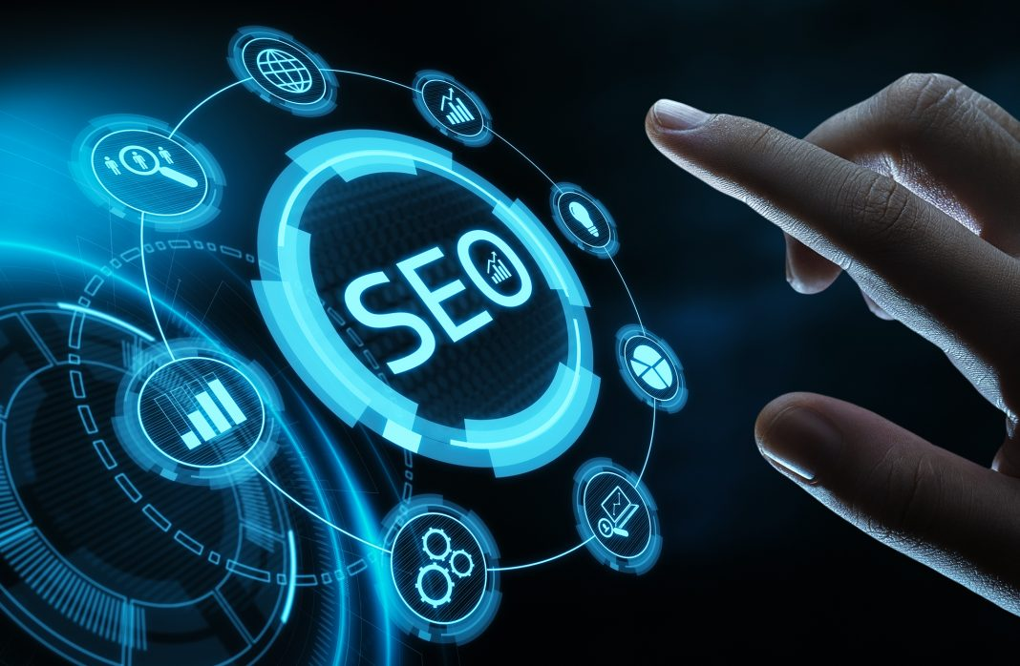
Link Analysis
Total In-Page Links
21 (mixture of internal and external links). Most are dofollow.
Anchor Text Examples
Learn more
Read the report
Discover more about our work
Contact us
Browse job listings

Slide 15

Broken Links
Broken Links Detected: ❌ http://cognizant.com/fragments/us/en/site/contactus\_widget\_form/sticky\_contact\_us
Recommend updating or removing broken links to enhance user experience and SEO.

Slide 16

Conclusion & Recommendations
Mobile Responsiveness
Critical improvement needed.
Language Declaration & Encoding
Essential for SEO and accessibility.
Analytics Implementation
Required for performance tracking.
Social Integration
Enhance social presence and engagement.
Your website demonstrates strong performance in areas such as page speed, URL structure, and compression. However, critical improvements are needed in mobile responsiveness, language declaration & encoding, analytics implementation, social integration, and broken link resolution. Prioritizing these areas will boost usability, SEO visibility, and user experience.

